Slide 1
Team 274 DevOps Track
Pro Shop Project
Abdelrahman Ayman
Abdelrahman Mahmoud
Abdullah Hamada
Karim Fathy

Slide 2
Presentation Main Points
Introduction and Project stack
Containerzation and its orchesrtration
IaC & configuration Management
CI/CD pipline
Monitoring and Observability

Slide 3
01
Intro

Slide 4
Introduction
Project Overview
Frontend
Backend
DevOps Technologies

Slide 5
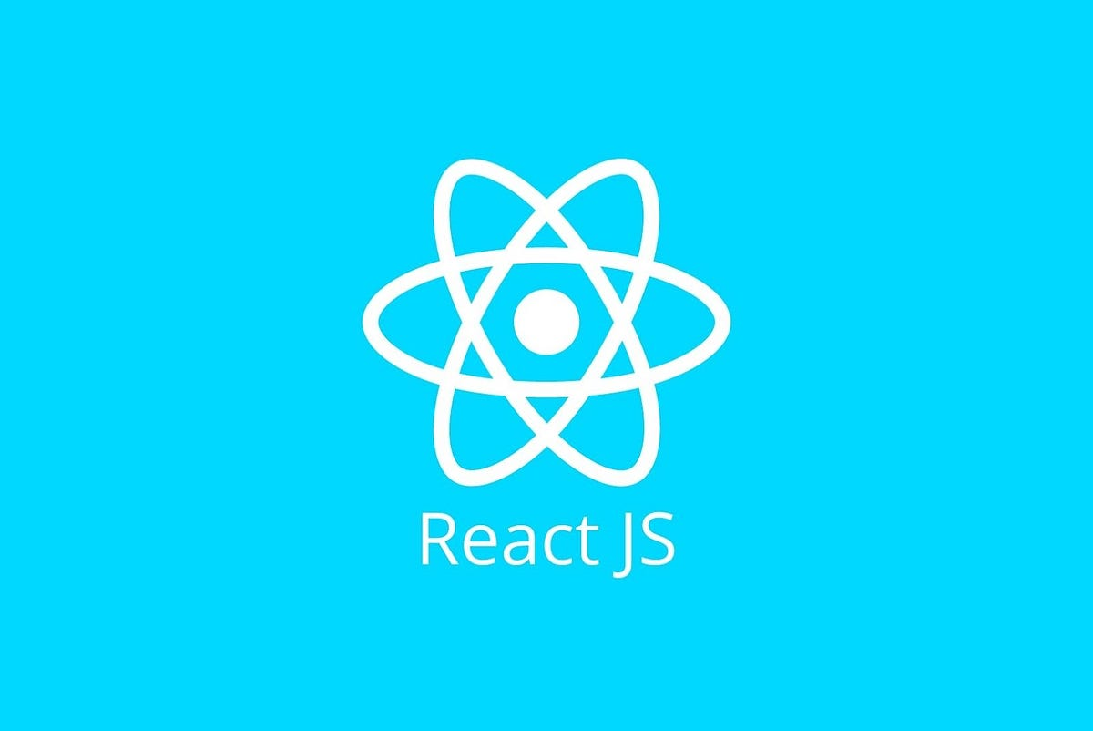
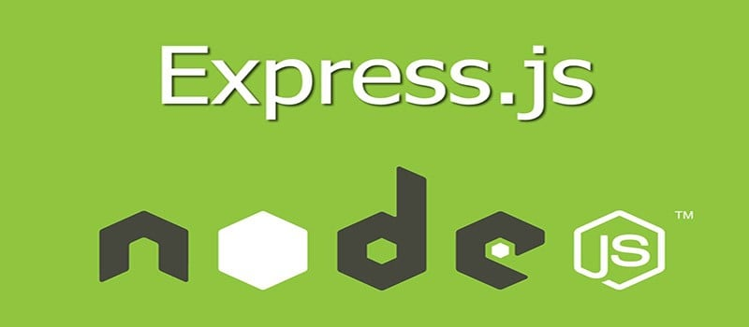

Project Overview
Node.js with Express.js framework
Stack
containerization
Orchestration
IaC
Mern
Stack
Docker & Docker compose
Using Kubernetes
Terraform and AWS
Pipeline
Security
GitOps
Monitoring
DataBase
Gitlab
Trivy & npm audit
ArgoCD and Helm
Prometheus & Grafana
Mongo
Backend
Stack of our project
Frontend
React.js

Slide 6
Stack of our project
Frontend
DataBase
Backend
React.js
Mongo
Node.js with Express.js framework

Slide 7
02
Containerizing

Slide 8
Containerization and Orchestration
Docker
First For Backend

Slide 9
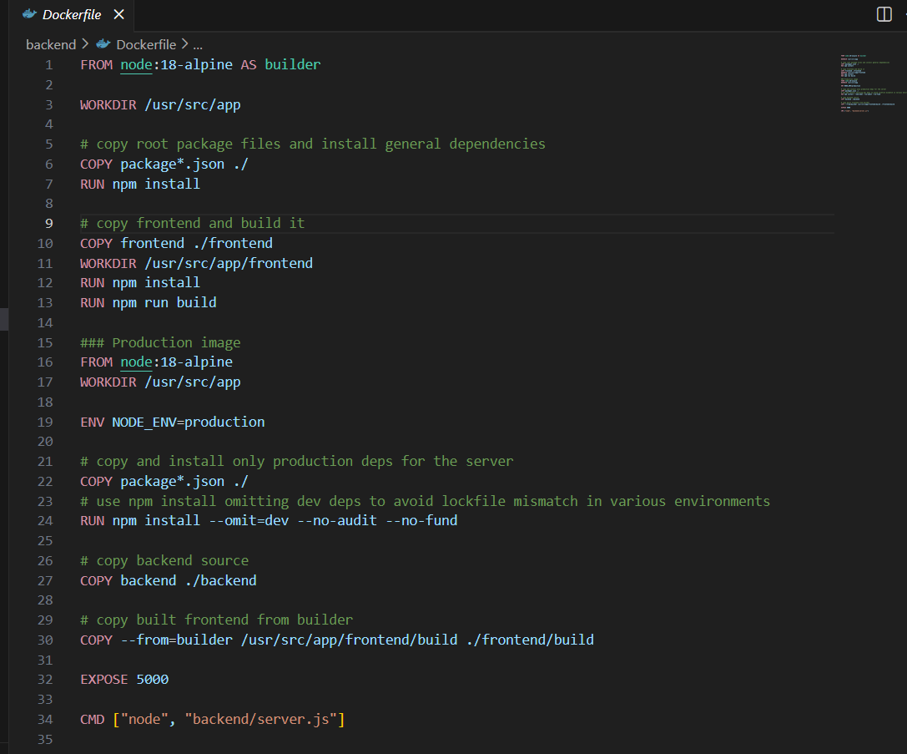

Slide 10
Containerization and Orchestration
Docker
First For Backend
Compose
Compose all the project

Slide 11
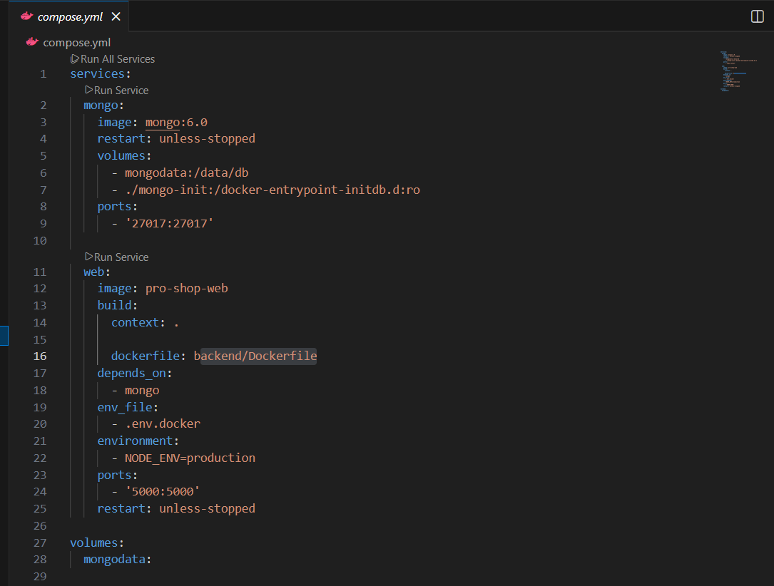

Slide 12
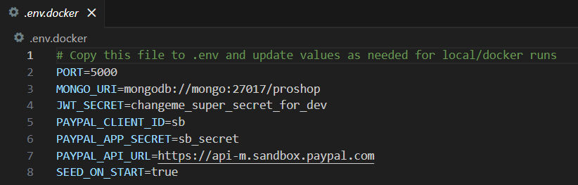
Also .env file

Slide 13
Containerization and Orchestration
Docker
First For Backend
Compose
DB K8S
Compose all the project
Manifests

Slide 14
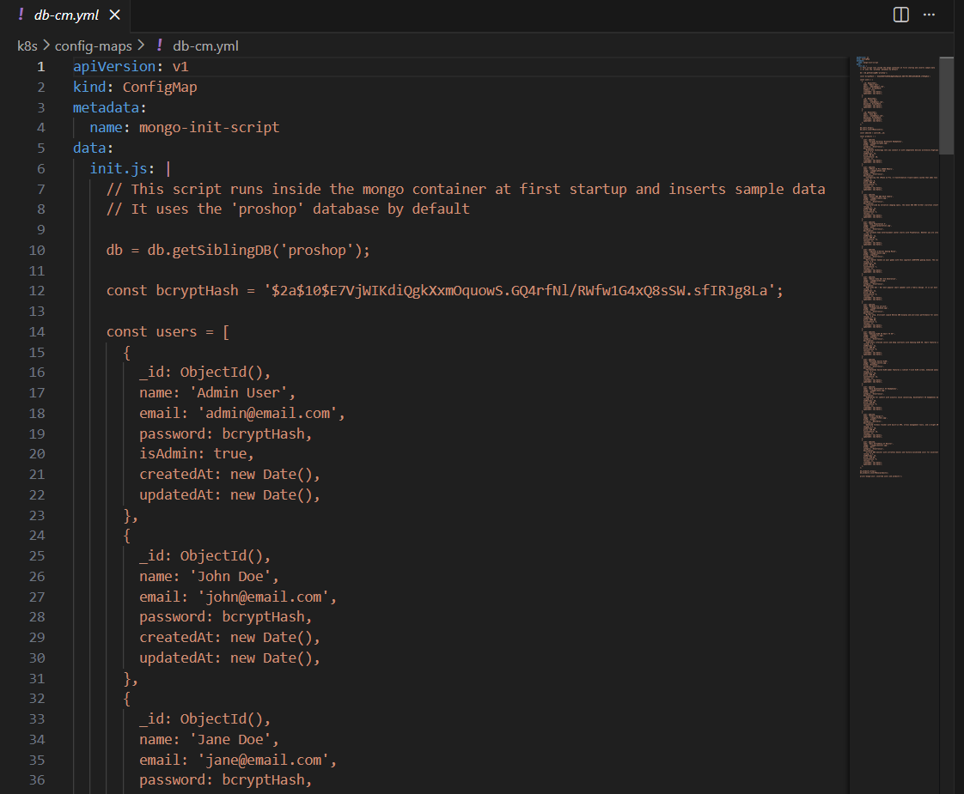

Slide 15
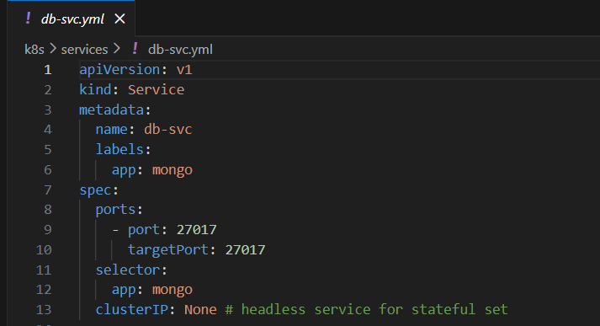
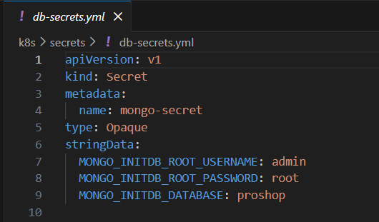
Service
Secrets

Slide 16
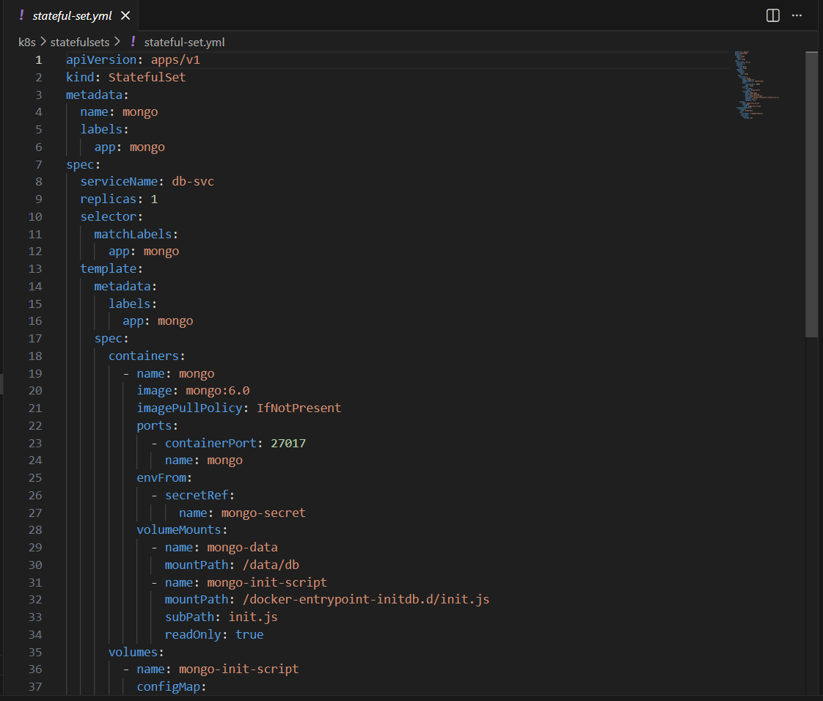
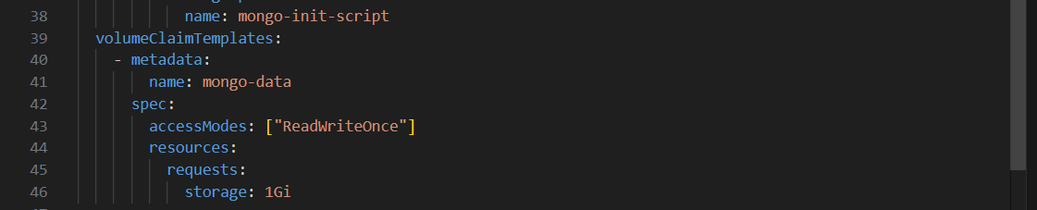

Slide 17
Containerization and Orchestration
Docker
App K8S
First For Backend
Manifests
Compose
DB K8S
Compose all the project
Manifests

Slide 18
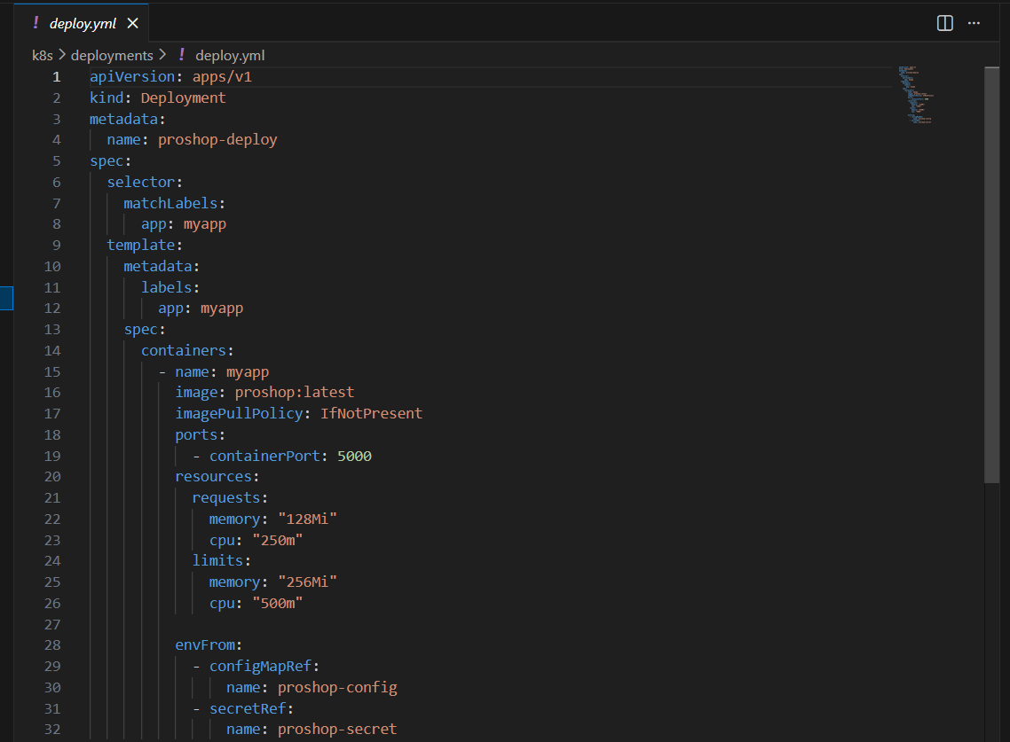

Slide 19
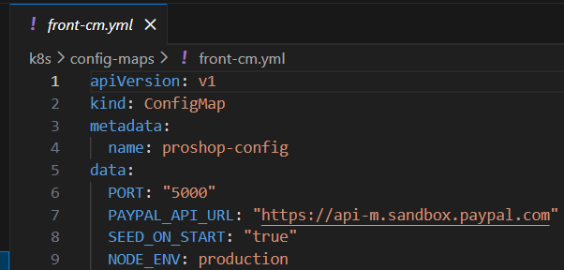
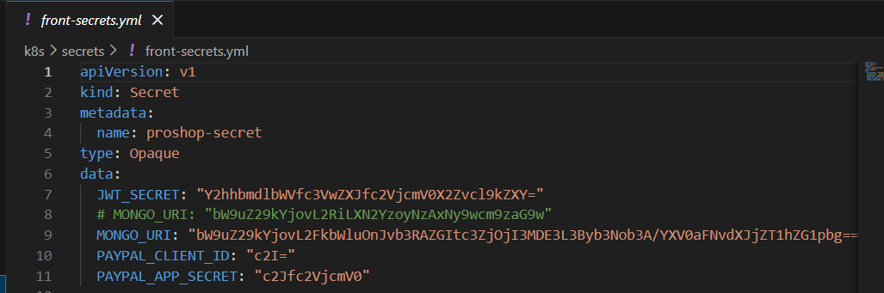

Slide 20
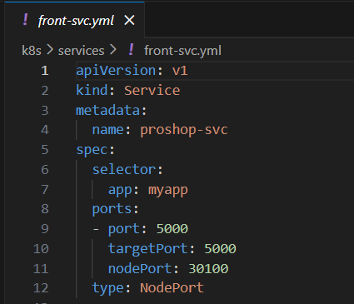

Slide 21
03
Ansible

Slide 22
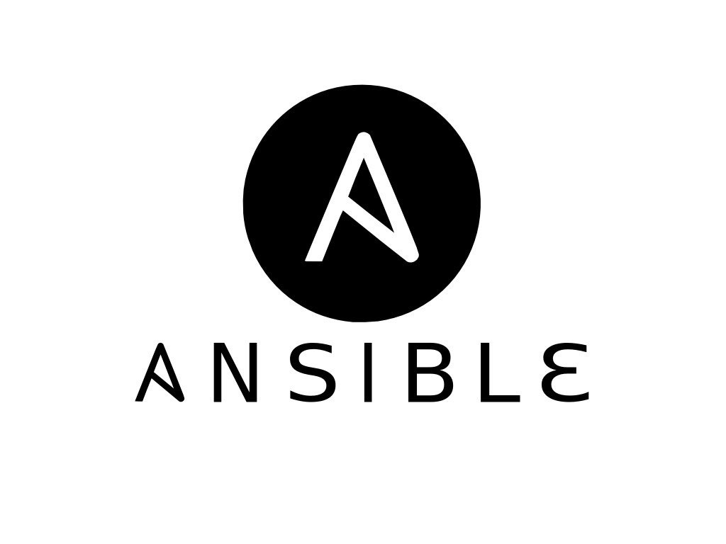
check the operating system,
install required packages,
install Docker if missing.
prepare the project folder, copy the needed files, and starts the Docker Compose stack.
After deployment, it waits for the app to start and shows the access URL. It also supports a cleanup mode that stops the stack and removes the project directory.

Slide 23
04
Pipeline

Slide 24
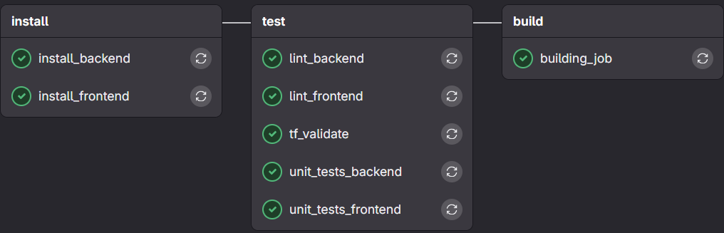
Using Gitlab, Our stages

Slide 25
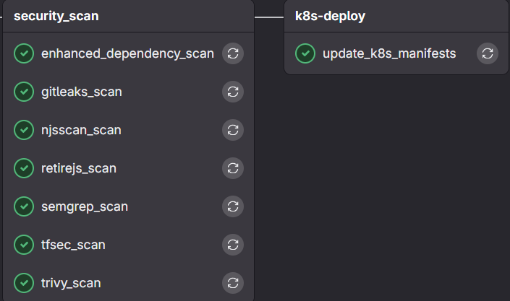
Using Gitlab, Our stages

Slide 26
DevSecOps
Security
Trivy
semgrep
Gitleaks
NJSScan
Retire.js
Image scanning
Static application security testing
Search for secrets in code
JS security scan
Known JS vulnerabilities

Slide 27
DevSecOps
Security
npm audit
tfsec
Owasp
Dependency vulnerabilities
Infra Scanning
All the Previous achieve Top 10 Owasp vulnerabilities

Slide 28
DevSecOps
Dev & Ops
Dev
Ops
Ops
Install and test
Build Docker Image
K8s Deploy

Slide 29
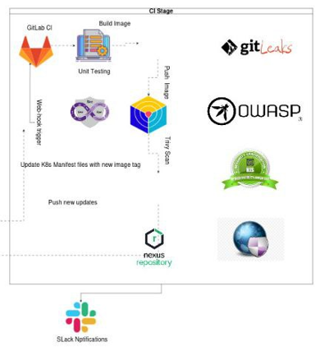
Here is our Full CI stage
Before Going to CD stage let’s apply gitops concept

Slide 30
05
GitOPS

Slide 31
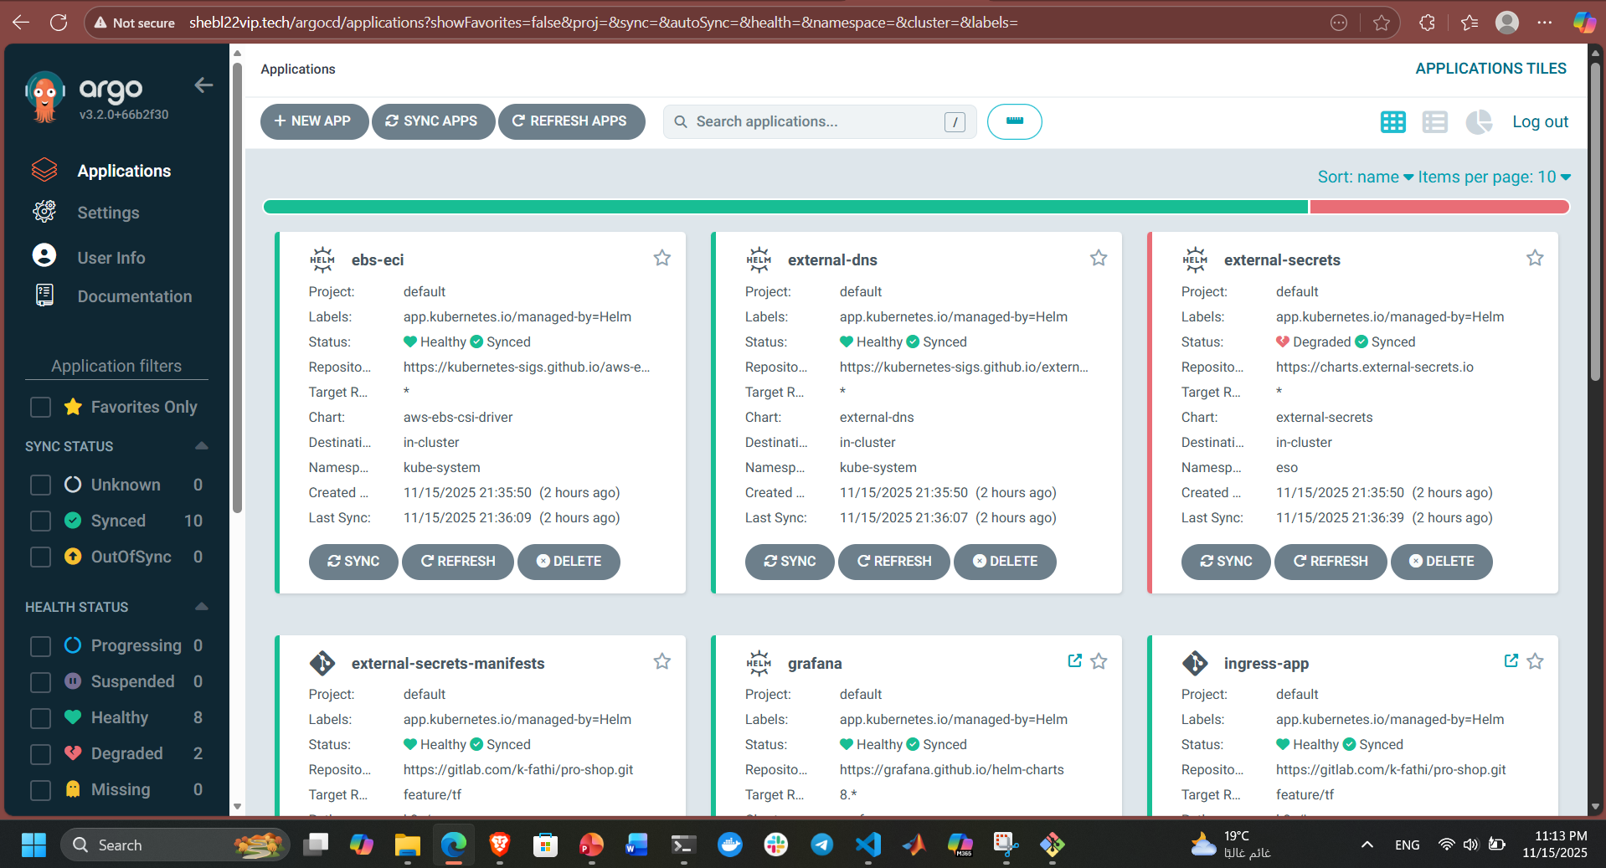
ArgoCD

Slide 32
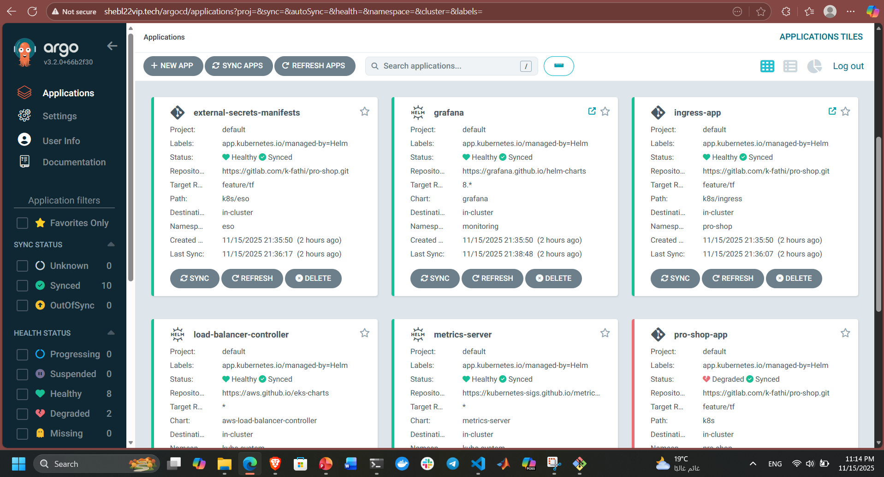
ArgoCD

Slide 33
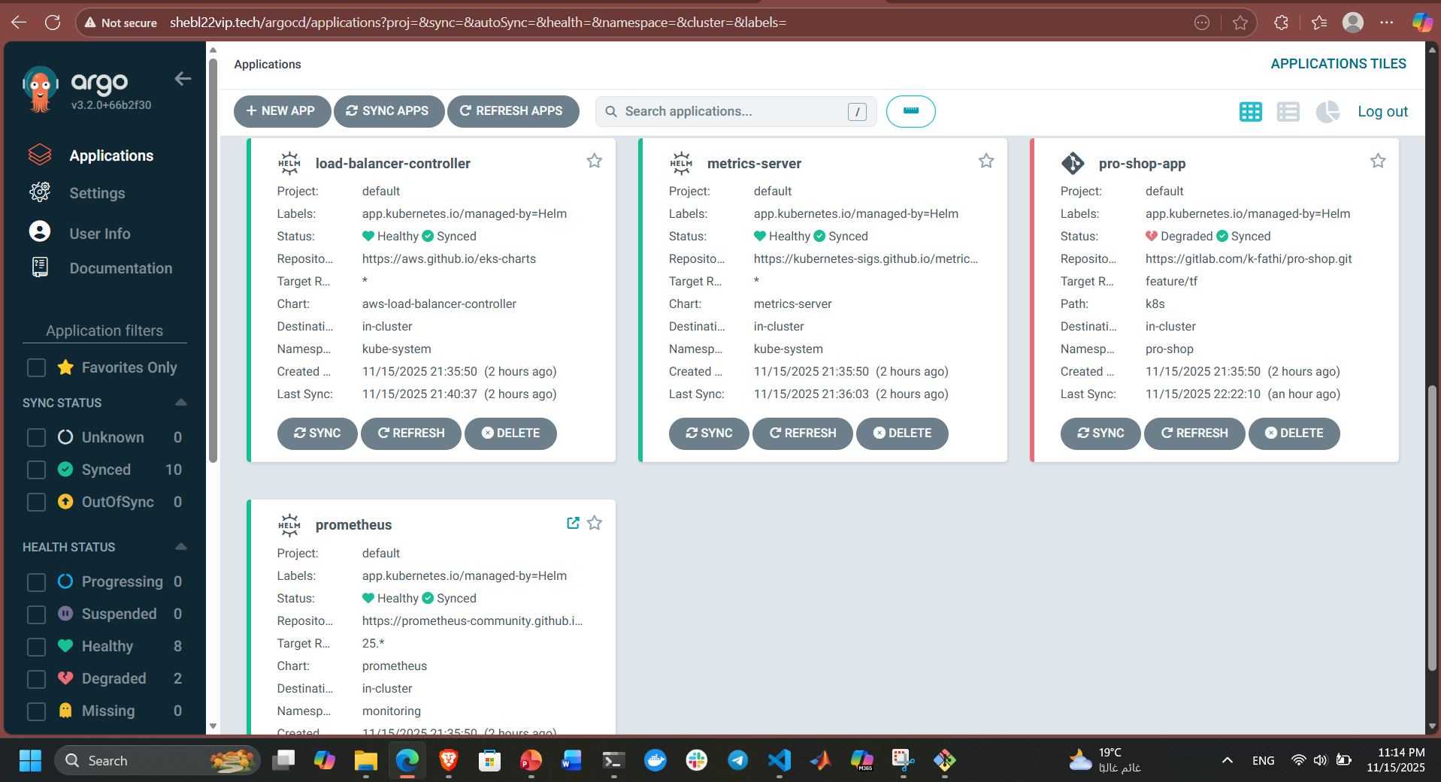
ArgoCD

Slide 34
06
Infrastructure

Slide 35
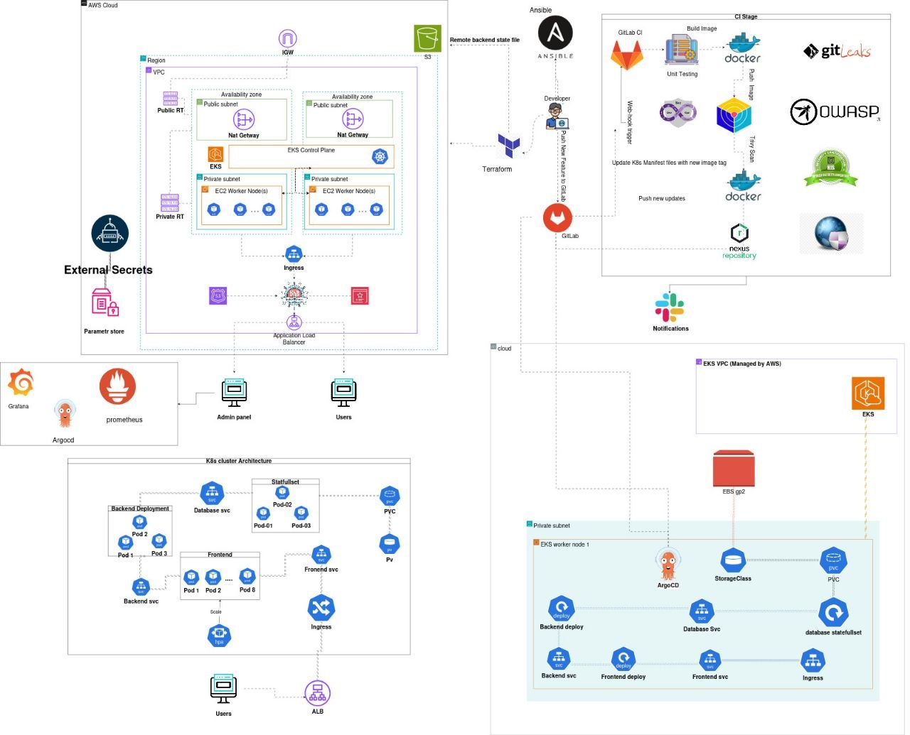

Slide 36
07
Monitoring

Slide 37
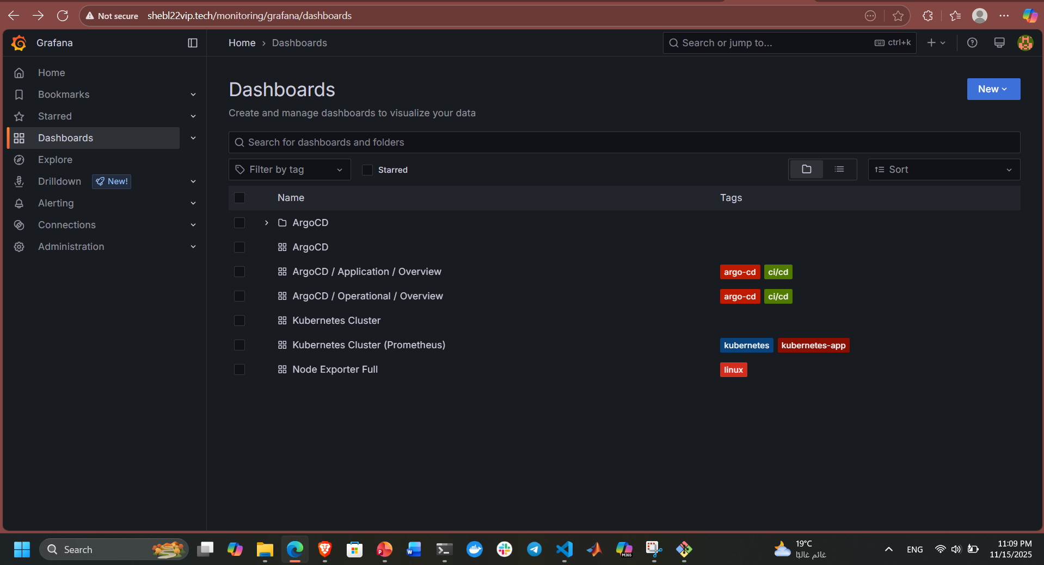
Grafana

Slide 38
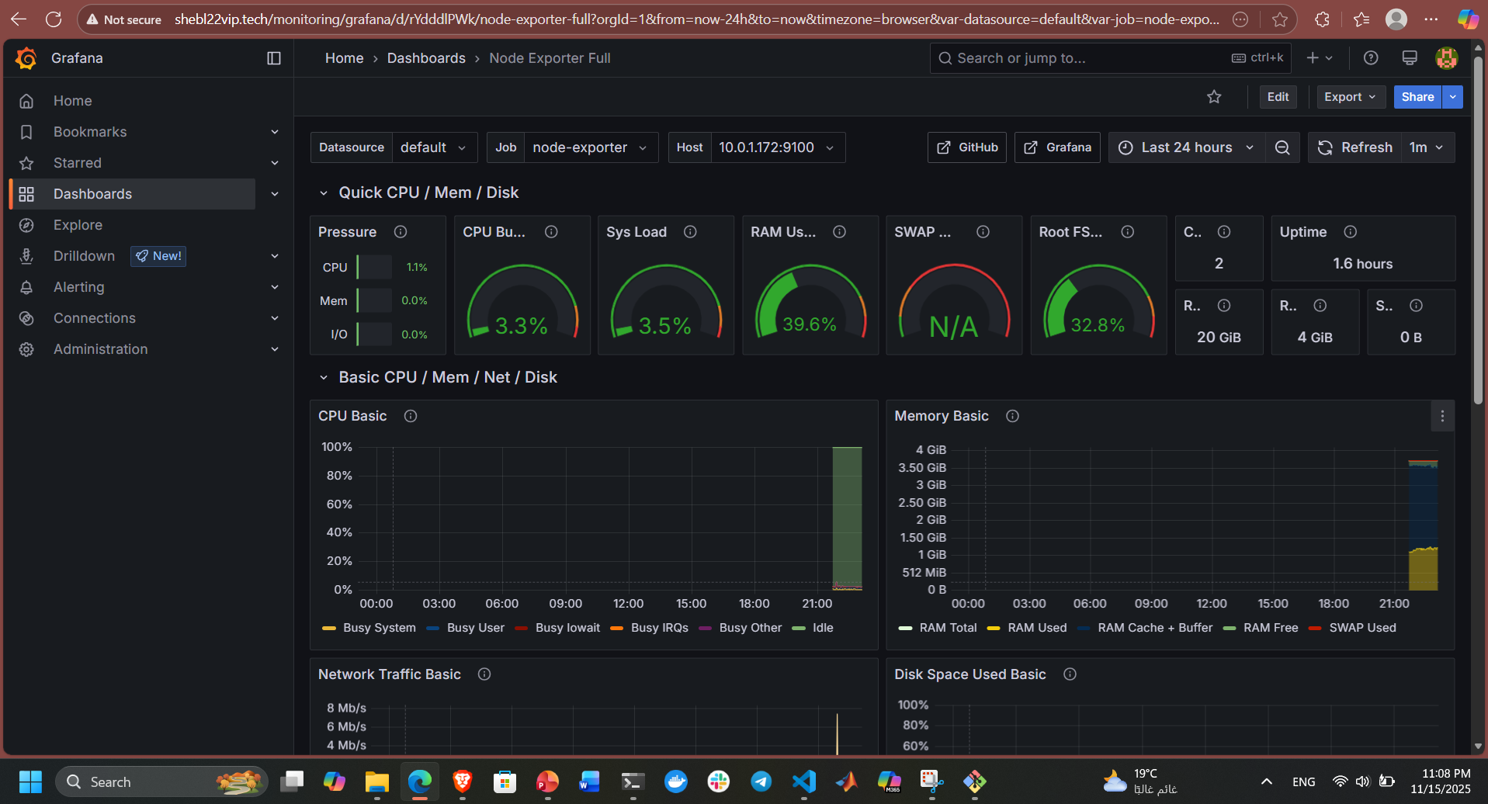
Grafana

Slide 39
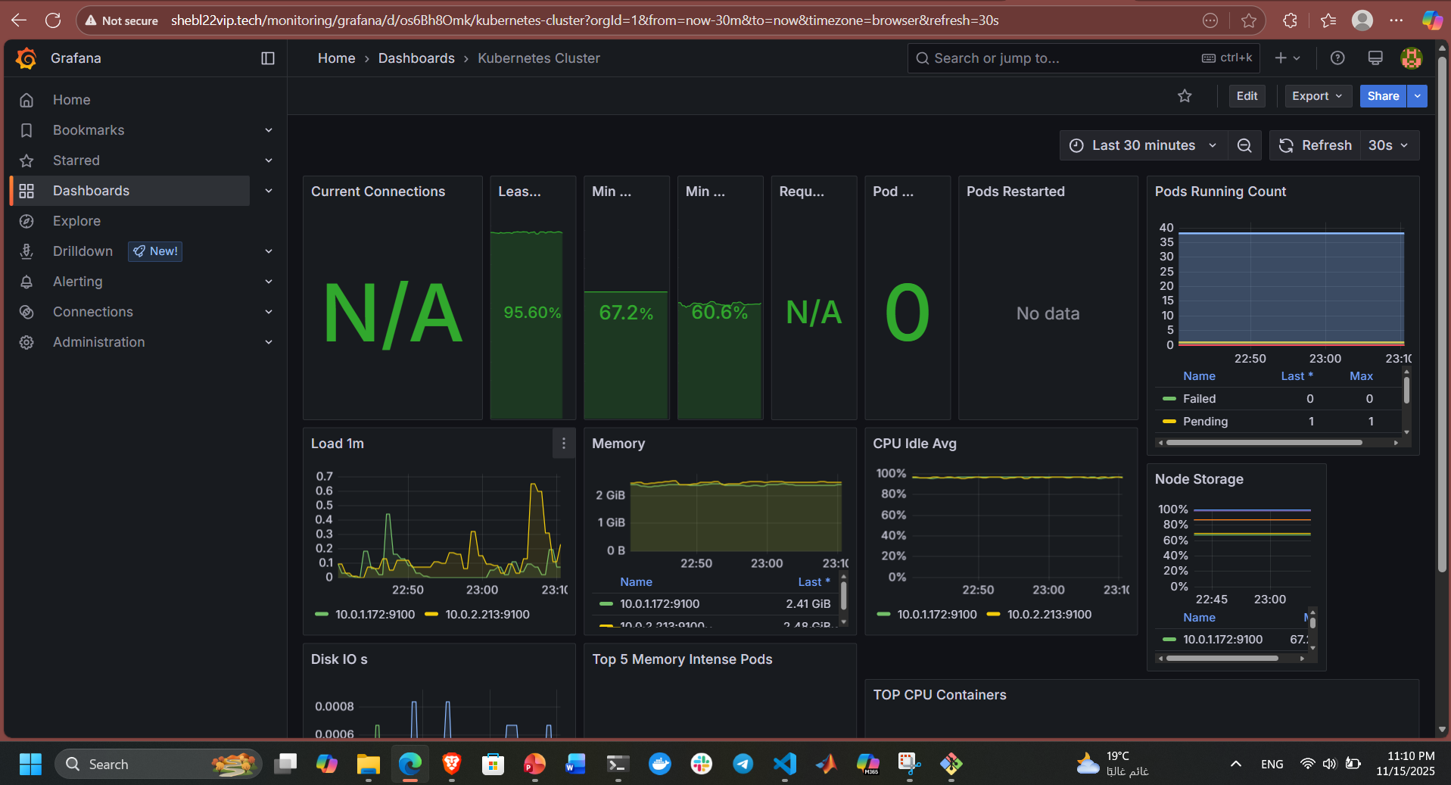
Grafana

Slide 40
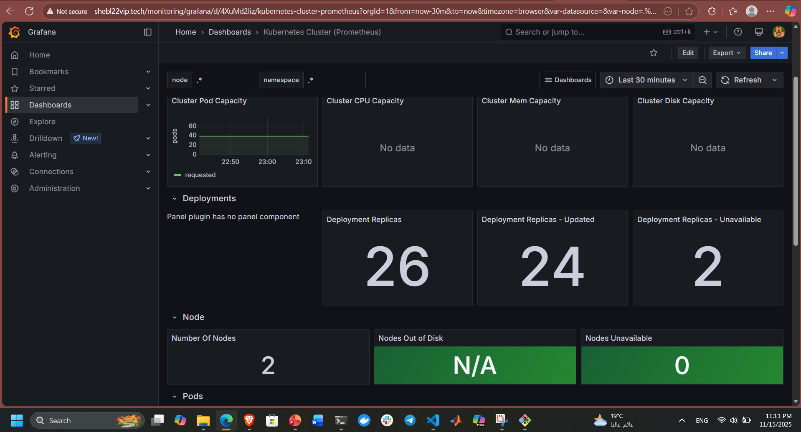
Grafana

Slide 41
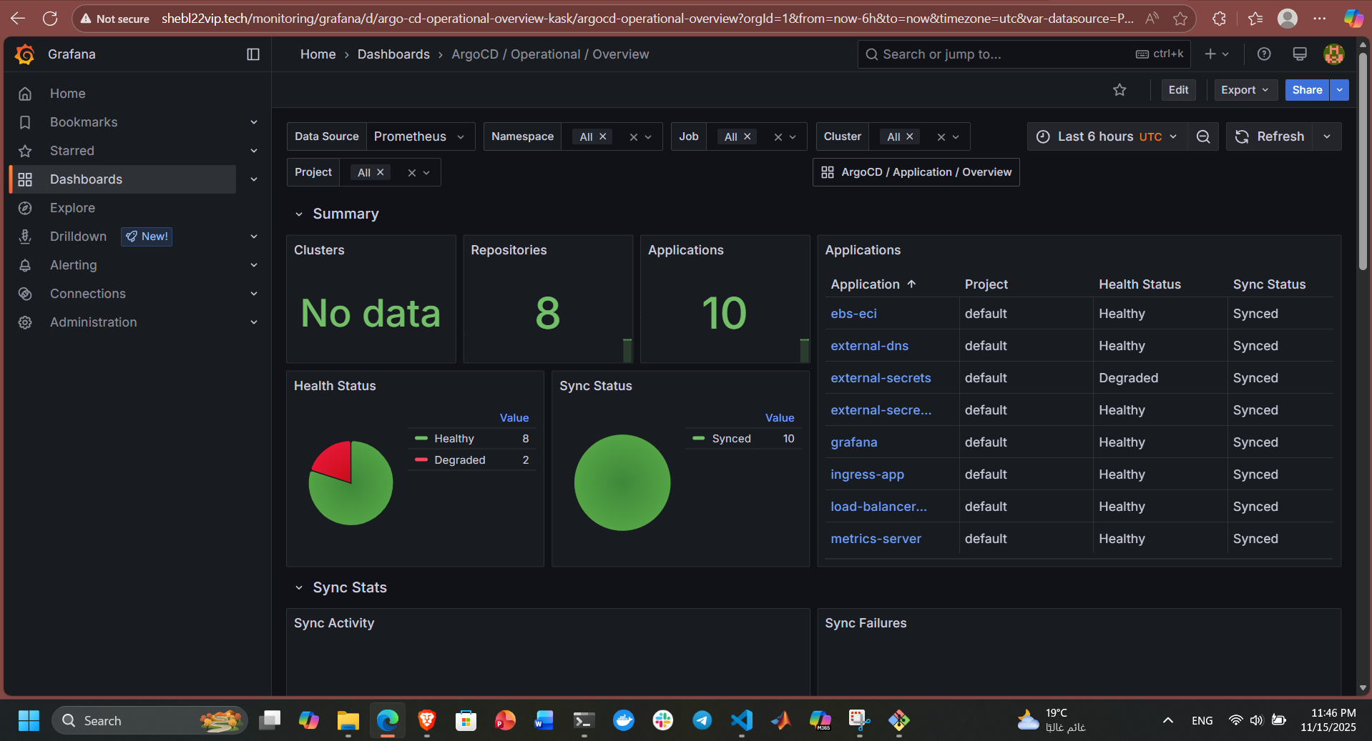
Grafana

Slide 42
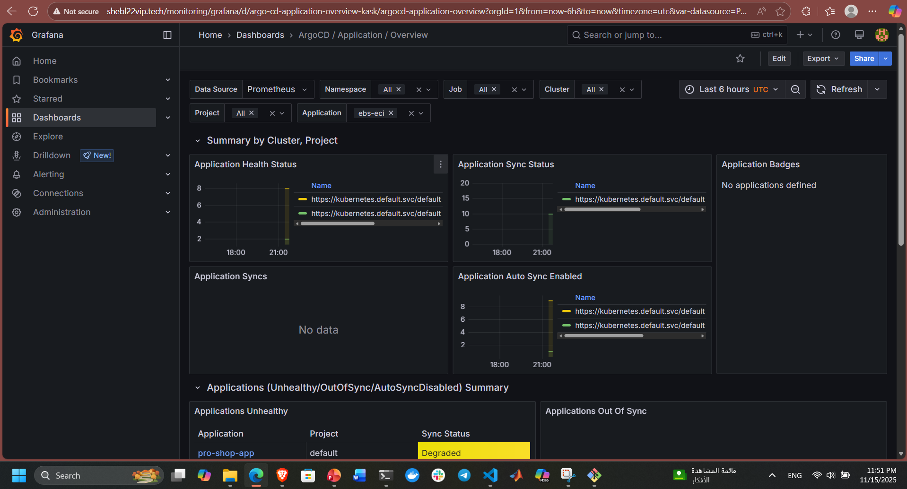
Grafana

Slide 43
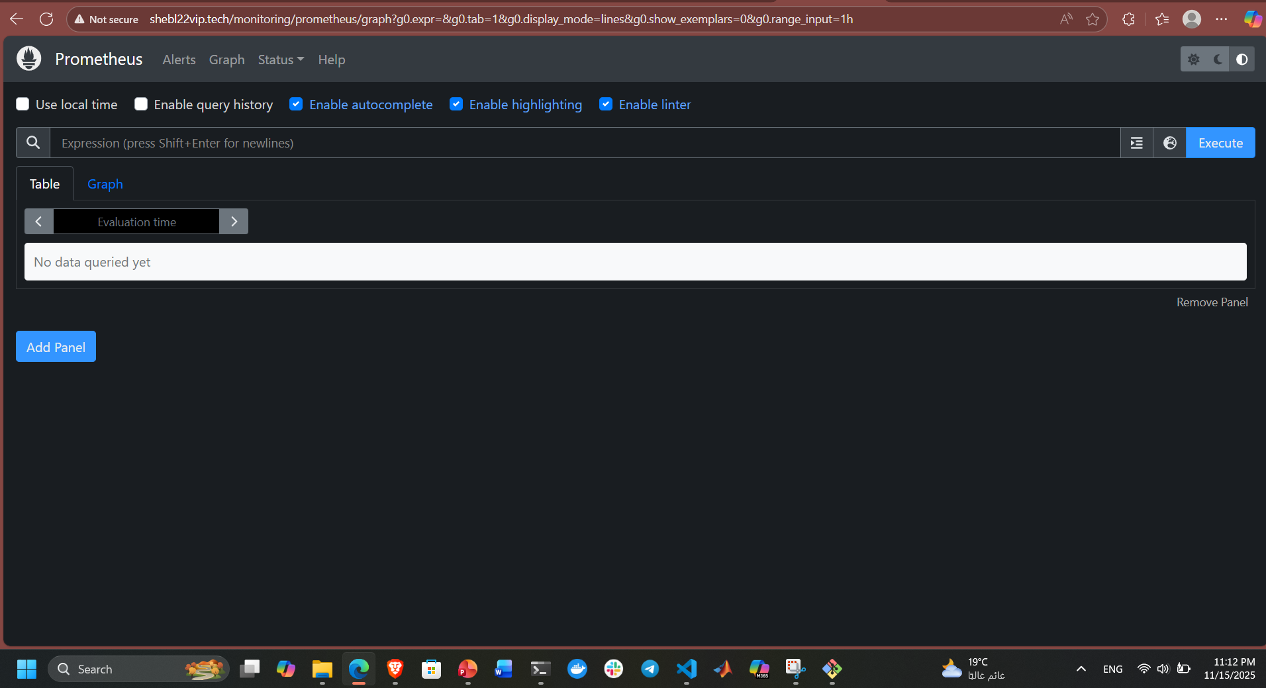
Prometheus

Slide 44
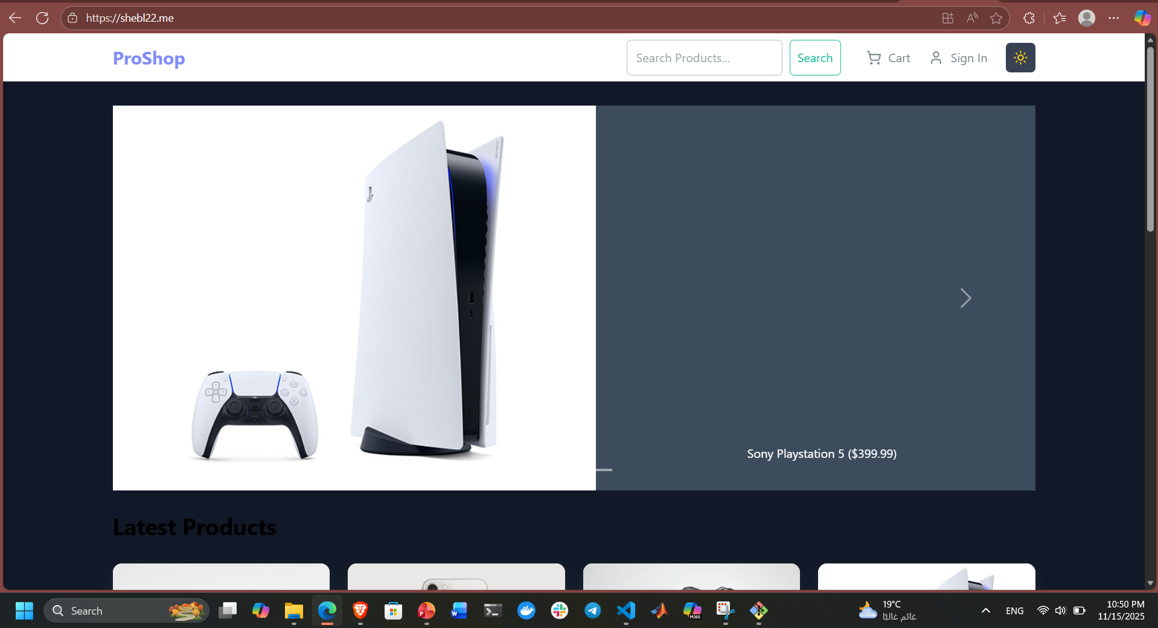
Finally our App

Slide 45
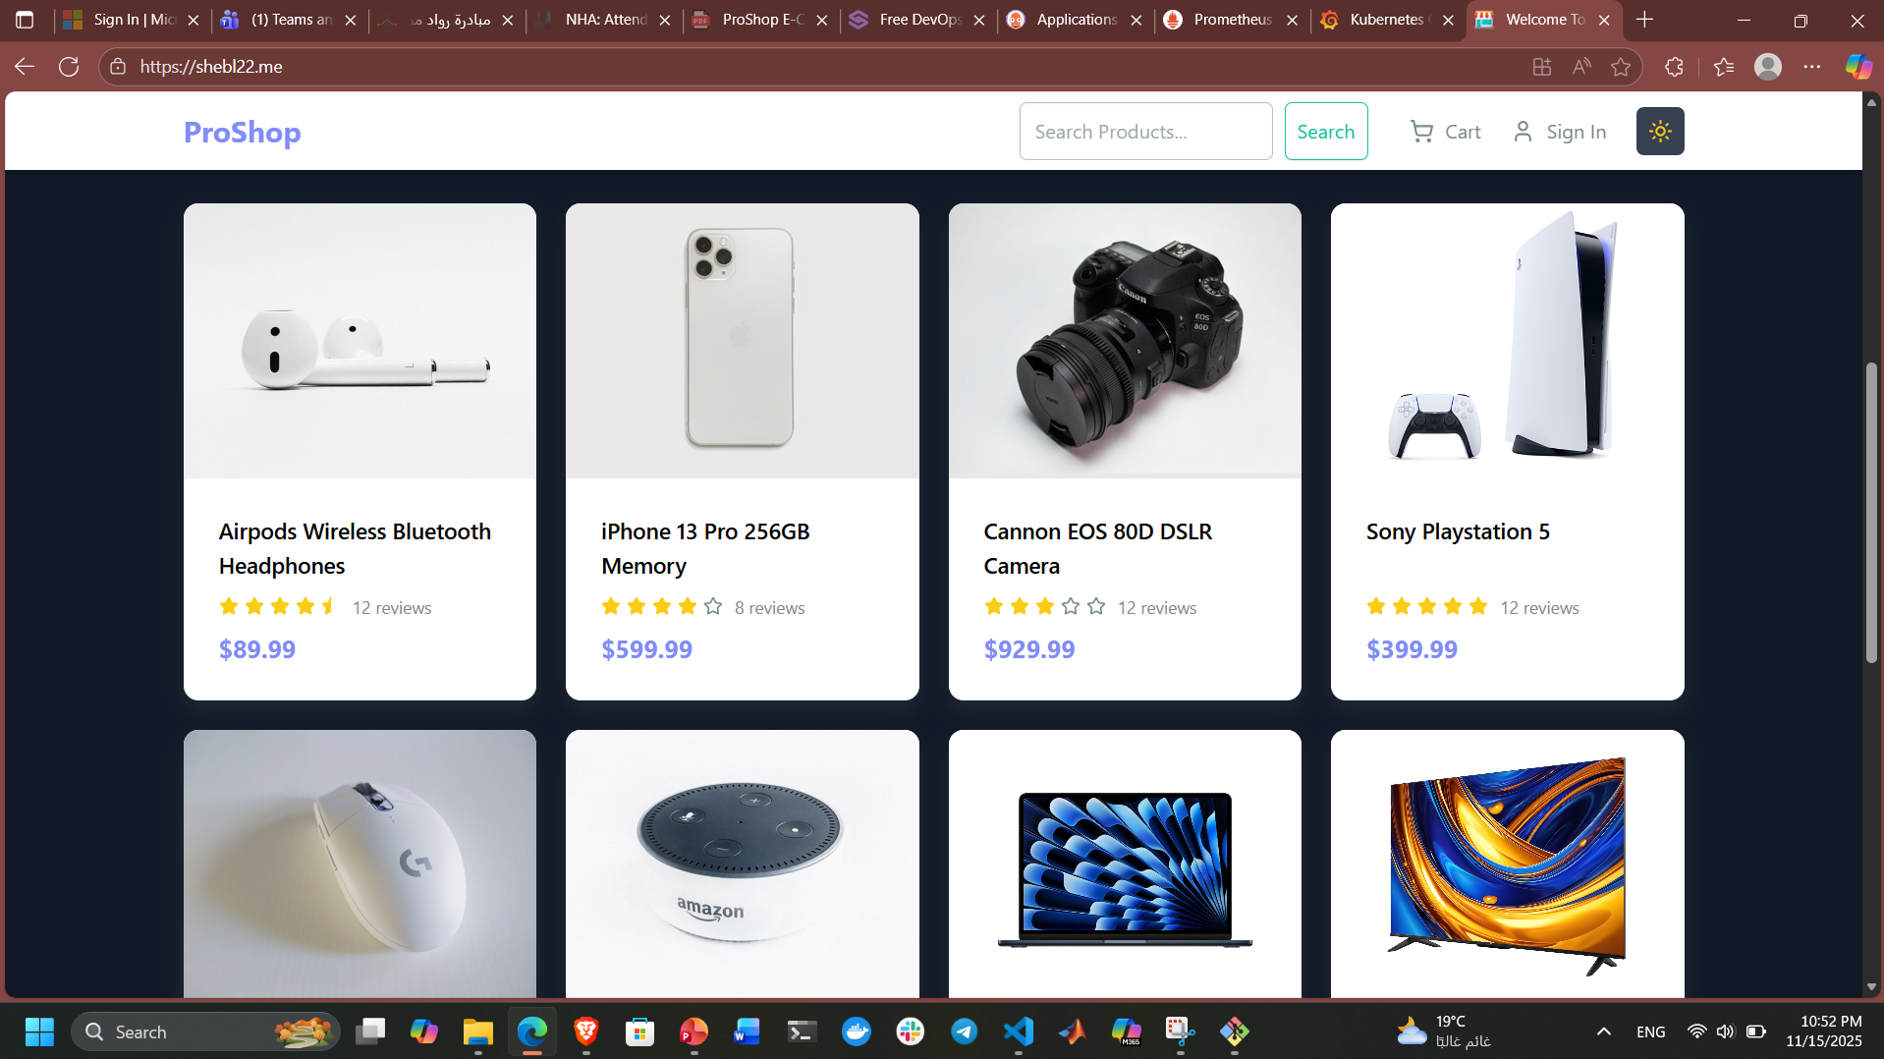
Also our App

Slide 46
Thank You
Team 274

